Slide 1

AASC Lesson 2.5: Area Search
Notes:
Find guidance inserted in the note section of each slide.

Slide 2

Overview
2.5.1 Purpose of Area Search
2.5.2 Hides and Caches
2.5.3 Threat Assessment
2.5.4 Area Search – BAC(Low Threat)
2.5.5 Area Search – Winthrop Theory (Med Threat)

Slide 3
Terminal Learning Objectives
At the end of this lesson, participants will be able to effectively conduct low and medium threat area search.

Slide 4
2.5.1 Purpose of Area Search

Slide 5
Purpose of Area Search
Principally a force protection measure (protective search)
Confirm absence of a EO threat when holding ground
E.g. An overnight stop on a vehicle convoy
E.g. Searching the open areas of a camp/operating base following indirect fire attack
E.g. Searching an open area before constructing a new camp/operating base.
Area Search may also be part of pre-planned operations to deny adversary use of IED making materiel (pre-emptive search)
E.g. Searching for hides and caches
Area Search can be a high threat operation.
Outside the scope of Intermediate search
HEAT factors to be used to determine if tasks is suitable.
Notes:
In a UN Peace Support Operating environment, area search is typically a defensive operation to provide a level of assurance, and/or confirm the absence of adversaryresource when holding ground for a prolonged period.
Area Search may also be part of pre-planned operations to deny adversary use of IED making materiel (pre-emptive search). In this instance, Area Search is principally an offensive operation and is used to locate adversary resources secreted in hide locations. It uses the principle that an adversary follows identifiable criteria when attempting to conceal resources.
Area Search can be a high threat operation, particularly when employed as a offensive operation (pre-emptive Search). Hides and caches may be protected with IEDs and booby traps. In these conditions, Area Search should not be carried out by All Arms/Intermediate Search teams. Determination of threat may be considered using the HEAT factors and a threat assessment.
This includes pattern analysis, known as the ‘Winthrop Theory’, enabling Searchers to identify the most likely areas to contain a hide.

Slide 6
2.5.2 Hides and Caches

Slide 7
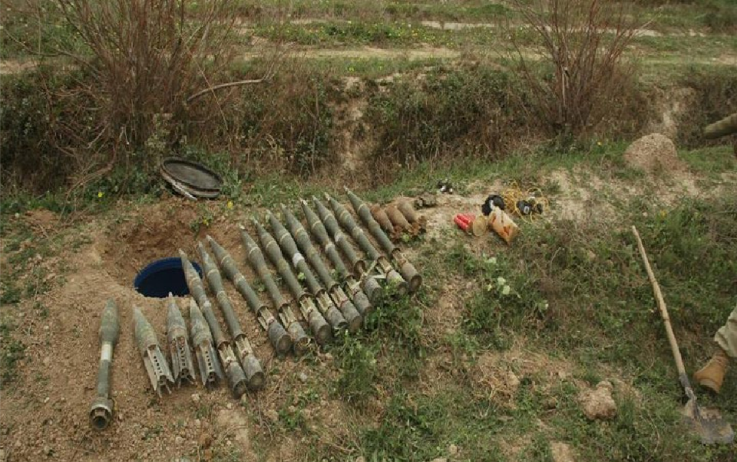
Hides and Caches
Notes:
The procedures employed during an Area search are based on a low level of threat in recognition that it is unlikely a search team would be specifically targeted as part of a pre-planned attack. An opportunist may be prepared to attack a team by shooting or initiating an incident in another location to create a distraction. If working in an urban area, there is always the risk from public disorder. It is possible a hide could be protected by a victim-operated device either within the hide itself or at the access point. If this is suspected, advice from S2 should be sought prior to the search commencing. Where there is a significant threat from a viable improvised explosive device (IED) within the area to be searched, this should be planned and conducted by advanced search assets.
Image courtesy UK MOD

Slide 8
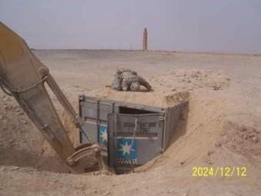
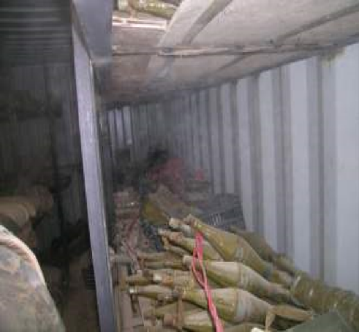
Hides and Caches
Long term
Notes:
Long-term hides are likely to be well sited, waterproofed and designed to house bulk items in numerous quantities, potentially for prolonged periods of time. Long-term hides may be specifically constructed pits or buildings, depending on the exact requirements
The two images represent an example of a long term hide/cache. Image source unknown.

Slide 9
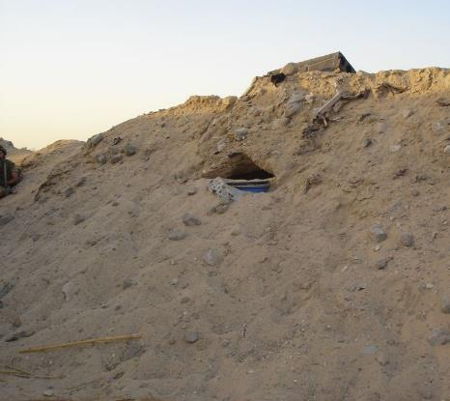
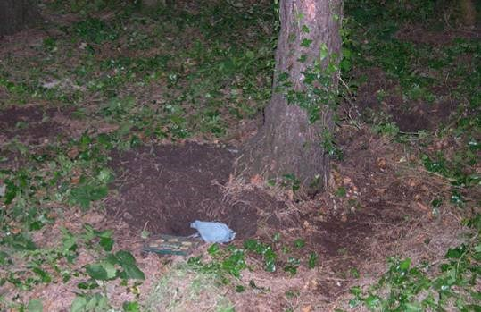
Hides and Caches
Transit
Notes:
Transit hides are generally located in or on routes leading to the resource destination. They are probably not designed for long-term storage, although they may be purpose built. They are often locations at which resources are transferred from the supply network to a perpetrator. Although probably not stocked for long periods, transit hides may be used on many occasions by one or several perpetrators

Slide 10
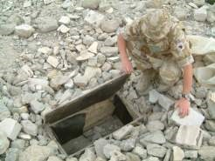
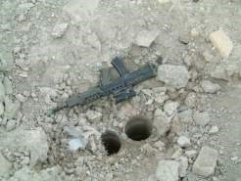
Hides and Caches
Short term
Notes:
Short-term hides are generally close to the scene of an incident and used by a perpetrator to conceal an item immediately before and after an incident. This enables a perpetrator to leave the area without incriminating items to link him to the incident. In some cases, convenience and accessibility outweigh concealment and such hides are vulnerable to search
Images are a examples of short term hides. Images courtesy of UK MOD

Slide 11
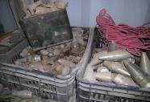
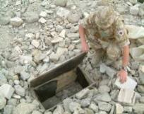
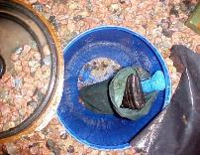
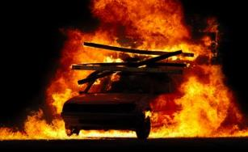
Hides and Caches
Long Term
Short Term
Transit
Notes:
The transition of resources from long term hide to incident by the terrorist follows a basic system:
Long term Hide: A trusted and experienced insurgent will be the major resources holder, usually know as the quartermaster. The location of the long term hide will be know to few, likely only the QM. Resources will be delivered and stored here by the QM for long periods of time until needed.
Transit Hide: The QM will move the required resources to a transit hide where it will be collect by another insurgent and taken to a short term hide for the bomb setter to collect. This may be a hide location known to many individuals.
Short term hide: This hide is used to place resources for short periods of time to enable the bomb placer to collect and emplace a device quickly.

Slide 12
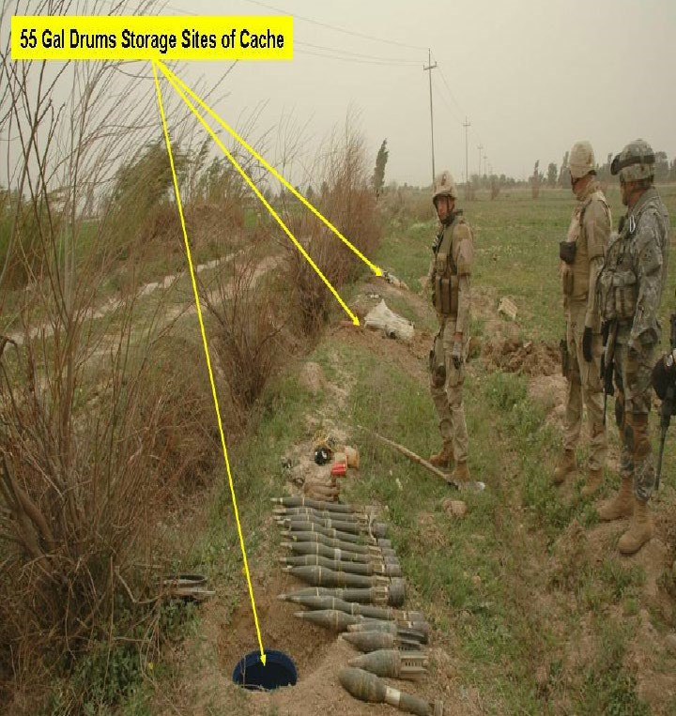
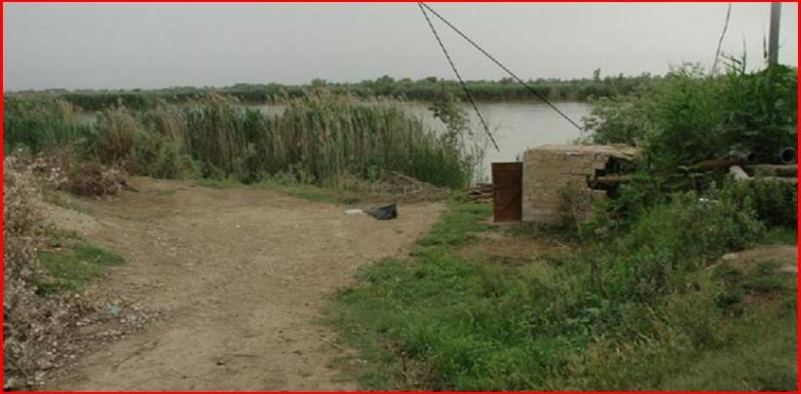
Hides and Caches
Characteristics - Available for immediate use
Notes:
Available for Immediate Use. Easily locatable using prominent features as reference points
Image Courtesy US DoD

Slide 13
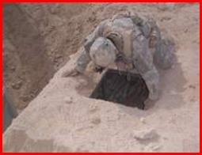
Hides and Caches
Characteristics - Accessible & Concealed
Notes:
A hide must be assessable to enable the adversary ease of placement or recovery of items from the hide
Image Courtesy US DoD

Slide 14
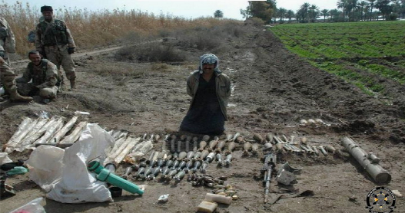
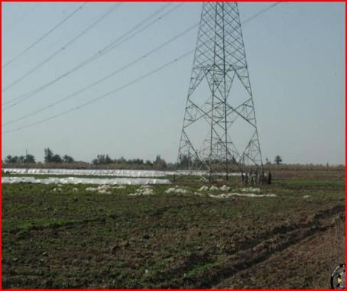
Hides and Caches
Characteristics - Non attributable
Notes:
A hide must not be attributable to individuals attempting to conceal resources
Image Courtesy UK MOD

Slide 15
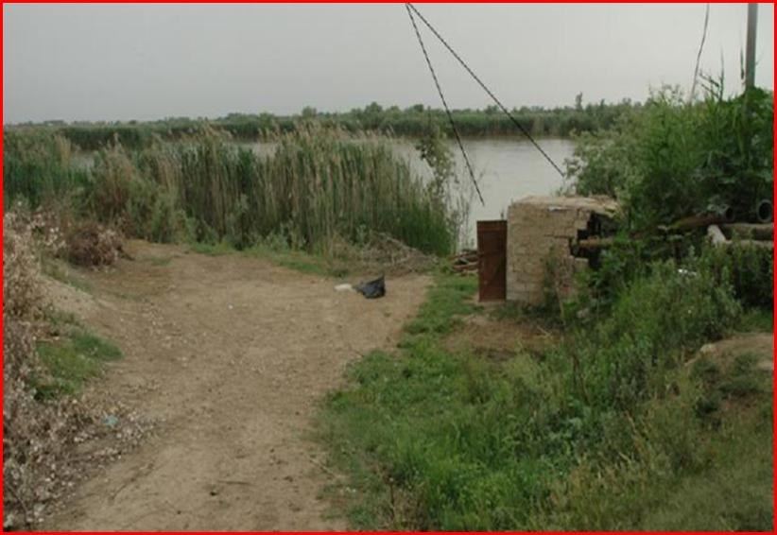
Hides and Caches
Characteristics - Locatable by day and by night
Notes:
A hide must be in a location such that it can be locatable both by day and night. It would be easy to find this building due to its close proximity to the track and in open view which can be followed easily in darkness
Image Courtesy UK MOD

Slide 16
2.5.3 Threat Assessment Linkage

Slide 17
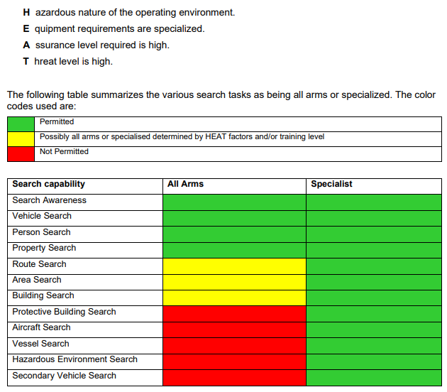
Threat Assessment
Area Search May or May Not be carried out by All Arms or Intermediate Search Teams subject to HEAT Factors which determine threat.
Notes:
Area Search May or May Not be carried out by All Arms or Intermediate Search Teams subject to HEAT Factors which determine threat.

Slide 18
Threat Assessment
Serial | Area Search Requirement | Defining Features | Type of Search to be conducted | Permitted by Intermediate Search
1 | Protective Search e.g. Long halt on convoy (overnight location), establishing new operating base, searching open areas after IDF attack | Benign area. Ground of own choosing. Minimal previous situational patterns set. | Battle Area Clearance (BAC) | Yes
2 | Pre-emptive Seach e.g. Searching for Hides and Caches | Short term, transit hides. No previous trends of protecting hides with IEDs or booby traps | Winthrop Theory | Yes
3 | Pre-emptive Seach e.g. Searching for Hides and Caches | Long term, purpose built hides, known associates, likely protected. | High Assurance Area Search | No – refer to Advanced Search teams/seek guidance from IED TM
Notes:
In order to determine if a task is appropriate for a search team to conduct a threat assessment should be carried out by a Search Advisor or IED threat mitigation advisor. As a search team, to help simplify this process and offer some guidance on the type of task you can or cannot conduct you can refer to this simple table/flow chart.
Instructor to talk through the table. Ensure you highlight the limitations of the All Arms/ Intermediate Search Team.

Slide 19
2.5.4 Area Search – BAC (Low Threat)

Slide 20
Area Search – BAC
Known as Battle Area Clearance (BAC)
Conducted after 5/25m check(s).
Conducted on ground where purpose is to hold for extended duration.
Where the threat is assessed as low.
and a low level of assurance is required.
Conducted in benign environment or with force protection.
Systematic Search.
Inc control Point.
Extended line, option to stagger.
Distances between searchers dictated by ground and equipment.
Confirms absence of surface EO.
Note: if purpose of land usage afterwards involves excavation - specialist assets required, consult TM advisor.

Slide 21
Area Search – BAC
Conditions for Battle Area Clearance
Urban areas
There is NO threat of Mines or IED’s
Where UXO is likely to be present either surface or subsurface.
Notes:
Conditions for surface BAC operations may include:
Urban areas
Clearance of Sub munition strikes
“kick out” due to demolition of ammo storage areas or vehicles
Where UXO is likely to be Found or have penetrated ground level

Slide 22
Area Search – BAC
General Equipment
Markers /cones/triangles/spray paint/pickets​
Metal detectors​ (for detector assisted search)
Marking sticks + hammer​
Red & White tape.​
Lane ropes​
GPS + measuring tape​
PPE​
Notes:
Marking flags/cones/triangles/spray paint/pickets​
Metal detectors​ (for detector assisted search)
Marking sticks + hammer​
Red & White tape.​
Lane ropes​
GPS + measuring tape​
PPE​
Comms (no radios inside hazard area!)
NTS Report + Site map.​

Slide 23
Area Search – BAC
Procedures
Site Set Up:
ICP minimum of 80-100m from hazard area
markers (joined at ground level with hazard tape/red rope)
Hazard area divided into working boxes
Search lanes usually not required
Irregular boxes can be divided by natural/man made features
Notes:
Site Set Up:
CP minimum of 100m from hazard area
Red/white markers 5m intervals
Hazard tape at ground level
Hazard area divided into 25mx25m or 50mx50m boxes (These may be broken down into 5mx5m boxes for better control of personnel)
Search lanes are usually not required for surface BAC
Irregular boxes can be divided by natural/man made features

Slide 24
Area Search – BAC
Surface Search Requirements
Distance between searchers (dependent on detector working distance)
Movement controlled by the TL
Actions On TL notified when UXO is located
UXO marked (clearance may continue at the discretion of the TL)
Accurate records of clearance and UXO maintained
Rummage search to clear obstacles
Notes:
When carrying out surface clearance operations in Ukraine the following requirements shall be met:
• The spacing of searchers is to be set to match the ground conditions ensuring that each individual searcher is capable of searching his/her assigned search width. In areas with heavy
vegetation a one-meter search width may be necessary. • The forward and lateral movement of searchers is strictly controlled by the Team Leader to
ensure that the whole area is properly searched. • The use of the 5 m x 5 m “sub boxes” is a very effective way to control the movement of the
individual searchers. • A reliable system of notifying the Team Leader when a UXO is located is used. This system
must ensure that searching ceases while the Team Leader inspects the UXO. • All located UXO are to be marked using a UXO marker (see SOP 03) and disposed of in
accordance with paragraph 09.12 below. Clearance may continue in a search box after a UXO has been located at the discretion of the Team Leader.
Accurate records of clearance and UXOs located are to be maintained.
Where necessary, ‘rummage search’ teams of 1 to 2 personnel equipped with metal detection equipment are to be assigned to search obstacles and areas of dense vegetation that cannot be safely or effectively checked by the search line.
Whenever possible the Team Leader should ensure that the end of the work day coincides with the completion of searching within a search box. This eliminates the need to mark daily limits of clearance within a search box.

Slide 25
Area Search – BAC
Surface Search – Detector Assisted
Surface BAC is normally conducted by a visual search; however, detectors may be used to assist surface search operations, particularly when conducting rummage search.
Notes:
Surface BAC is normally conducted by a visual search; however, detectors may be used to assist surface search operations, particularly when conducting rummage search or in areas of long vegetation.

Slide 26
Area Search – BAC
Surface Search Method 1
Notes:
Maximum of 1m between deminers
Searcher walks from the baseline perpendicular to the edge of the box visually searching a 1m wide lane to their front. Where the vegetation is long a detector/locators can be used to assist the search.
Cones/markers placed along at edge of searched area as he/she moves forward.
Once end of box the searcher peels round to search back in the direction they came from
As cones are passed, the searcher temporarily halts, and moves the marker to the limit of the new 1m lane.
If an item of UXO is located, the searcher halts and informs the TL. Red flag/marker placed 10cm in front of item.
TL to check item of UXO. Search to continue if safe to do so.
One all UXO has been removed from the box (if safe to do so) or destroyed/rendered safe and removed then TL to QC box and replace white marker with black marker

Slide 27



Area Search – BAC
Surface Search Detector Assisted
Notes:
Maximum of 1m between deminers
Searcher walks from the baseline perpendicular to the edge of the box searching a 2m wide lane to their front. locators can be used to assist the search.
2nd and further searchers move forward from the baseline when sufficient distance between searchers to avoid interference between search equipment and maintaining overlap of clearance.
Cones/markers placed along at edge of searched area as the last searcher moves forward.
Once end of lane the searcher peels round to search back in the direction they came from
As cones are passed, the searcher temporarily halts, and moves the marker to the limit of the new limit of search.
If an item of UXO is located, the searcher halts and informs the TL. Red flag/marker placed 10cm in front of item.
TL to check item of UXO. Search to continue if safe to do so.
One all UXO has been removed from the box (if safe to do so) or destroyed/rendered safe and removed then the area is marked as clear.

Slide 28
2.5.5 Area Search – Winthrop Theory (Medium Threat)

Slide 29
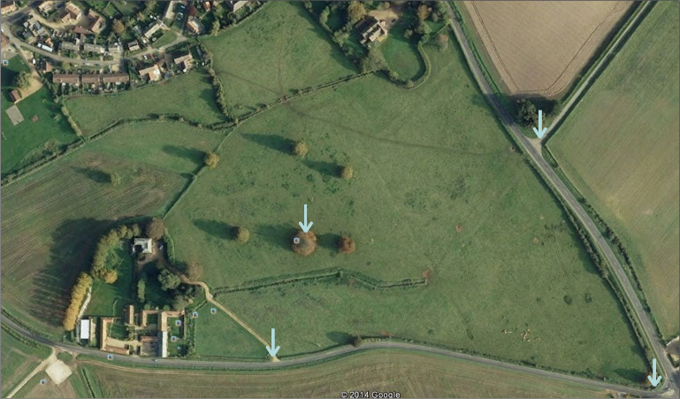
Area Search
Area search relies on the use of Winthrop Theory
This is the idea that items are hidden near easily identifiable reference points
Aid the person to be able to find the cache/hide
Notes:
Area search relies on the use of Winthrop Theory
This is the idea that items are hidden near easily identifiable reference points
Aid the person to be able to find the cache/hide

Slide 30
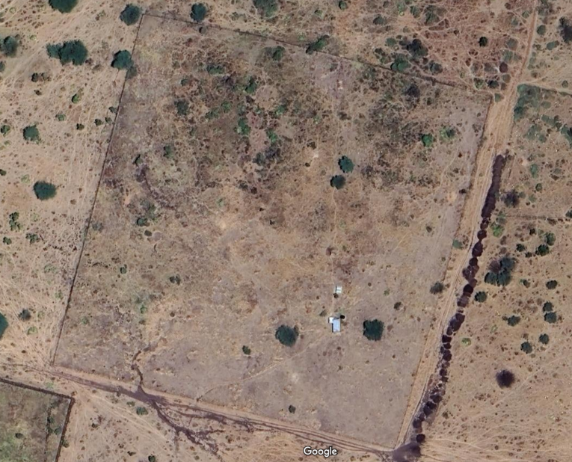
Area Search
Reference Points
Primary - the obvious marker that really stands out in the area
Secondary - a marker which is less obvious but can be easily found from the primary marker
Notes:
Explain primary and secondary markers.
Primary markers:
A sharp bend in the road
A large tree upon the bend in the road
A large lay-by just before the bend in the road
Secondary Markers:
Tree to rear of large tree next to bend in road
Line up two trees next to bend in road and site through to other side of road to smallest palm tree
Bend in road with large palm tree opposite end smaller palm next to road

Slide 31
Area Search
Information sources
Mapping
Photocopy
Recce
Reports
Notes:
Mapping:
It may not always be possible to get eyes on the target area and your only source of information which shows detail of the ground will be mapping. It is also useful for planning and briefing to mark routes, SSP, Heli pick up and drop off, Boundaries, limitations of areas and to identify ground features such high water, populated areas, open ground etc.
Photography:
As with the mapping aerial photography can tell you a lot about your areas of operation. If the theatre of operations has the facility, imagery can be exploited to identify anomalies, track paths, disturbed ground.
Recce:
If you get chance, a recce of the ground will yield useful information, whether by vehicle, patrol or heli. Identifiable areas will include, the lay of the ground, types of building, routes in and out, ICP’s and SSP.
Search Reports:
If available the Team Commander should read through previous rummage search reports to identify trends or patterns used. It may highlight previous problems or difficulties such as boggy ground, previous markers used, materials used in the manufacture of the hide itself etc..
Local Knowledge:
Talk to local commanders to find out about the area. If the locals are friendly this could also be a good source of intelligence. Speak to the interpreters, local forces and Police to gain intelligence.
If available the Team Commander should read through previous rummage search reports to identify trends or patterns used. It may highlight previous problems or difficulties such as boggy ground, previous markers used, materials used in the manufacture of the hide itself etc.

Slide 32
Area Search
Considerations
Threat – Are you the right team for the task?
Methods of Insertion/extraction
Target area
Pattern of life
Time available
Other agencies
Tactical situation
Notes:
Considerations when planning an area srearch:
Threat – Has a threat assessment been carried out? Are you the right team for the task?
Methods of Insertion/extraction – How will you get there and back with all your equipment?
Target area – How big is the search area? Can you achieve the task?
Pattern of life – Absence of Normal, presence of abnormal.
Time available – Based on size of area
Other agencies – Do you need other agencies e.g. IEDD or local police to deal with anything you find?
Tactical situation – Does the tactical situation allow for you to complete the task? Do you need additional security?

Slide 33
Area Search
Phase 1
Phase 2
Establish ICP
Select Reference Points
Phase 4
Phase 3
Search Reference Points
Walk the Boundary
Phase 5
Phase 6
Search the Boundary
Search Open Areas

Slide 34
Area Search
Phase 1
Establish ICP

Slide 35
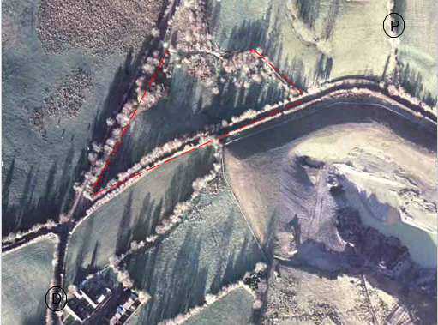
Area Search

Slide 36
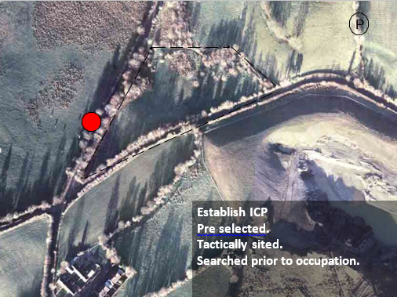
Area Search

Slide 37
Area Search
Phase 1
Phase 2
Establish ICP
Select Reference Points

Slide 38
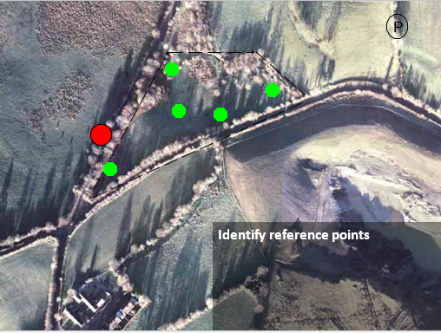
Area Search

Slide 39
Area Search
Phase 1
Phase 2
Establish ICP
Select Reference Points
Phase 3
Walk the Boundary (as per an isolation)

Slide 40
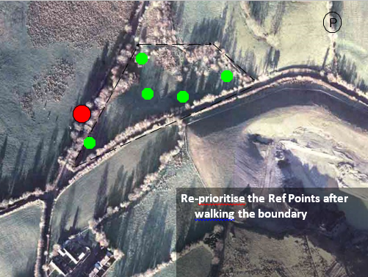
Area Search
Walk the boundary as per an isolation; PF, TW, Comd (ECM) and Cover person.
Notes:
Phase 3 – Boundary Check. The Search team, including MWD team (if used),
should walk the boundary, with the dog in front of the Search team. The Search team is
not searching for any hidden items, but walking the boundary to achieve the following:
a. To look for more reference points, out to 20 m outside the Search area.
b. To look for primary and secondary markers.
c. To confirm the boundary to the whole team.
d. To look for any additional access into the area.

Slide 41
Area Search
Phase 1
Phase 2
Establish ICP
Select Reference Points
Phase 4
Phase 3
Search Reference Points
Walk the Boundary

Slide 42
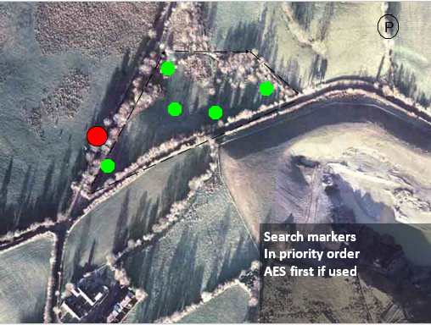
Area Search
Notes:
Each reference point is now search in order of priority. If an AES dog is used it must search the reference points first and any indication noted by scribe.

Slide 43




Area Search
5m – 25m Equip & Visual
End Point
5
m
15
m
Start Point
Starting at the center of the reference point and spiraling in to the 25 m point
Notes:
If used, the AES dog team should Search the reference point prior to the Search pair, with reference points Searched to a radius of 15 m. Starting at the center of the reference point and spiralling in to the 15 m point, Search pairs should have the following equipment available to them:
a. Appropriate detector based on the threat assessment and object to be found.
b. ECM – depending on the threat.
c. Digging implement.
d. Prodding implement.
e. Mine marking cone and pin markers.
f. Notebook and pen.
g. Aerial photography (if possible).
h. Camera.

Slide 44
Area Search
Phase 1
Phase 2
Establish ICP
Select Reference Points
Phase 4
Phase 3
Search Reference Points
Walk the Boundary
Phase 5
Search the Boundary

Slide 45
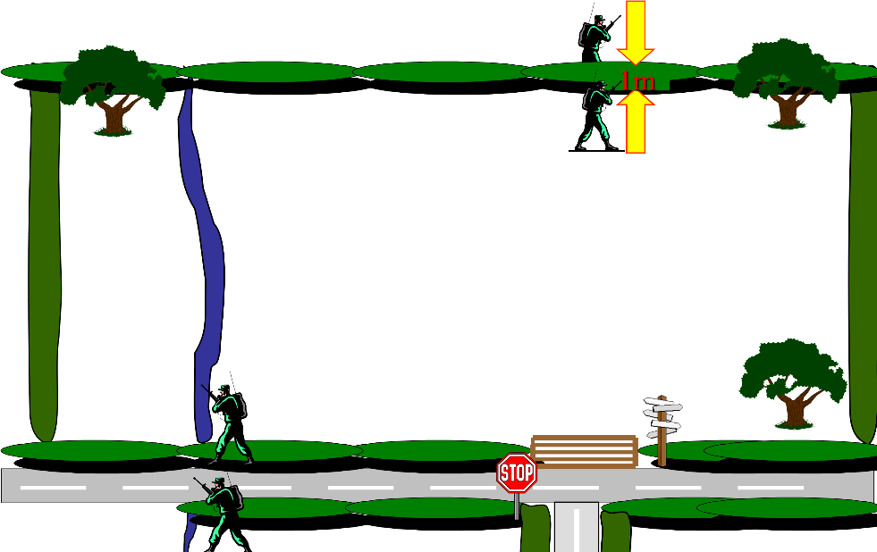
Area Search
Update picture and Slide to an isolation; one search team; PF, TW, Comd, Escort searching boundary as per an isolation.
Notes:
Boundary Search. The boundary should be searched by pairs
operating in different directions to ensure maximum Search coverage with each pair
completing a full circuit of the boundary, including an overlap. In addition, Searchers must
ensure an overlap of 1m within their areas. Within high threat areas Searchers must be no
closer than 10 m to one another and if appropriate, work under ECM cover.
Elaborate on the slide to confirm searching the boundary

Slide 46
Area Search
Phase 1
Phase 2
Establish ICP
Select Reference Points
Phase 4
Phase 3
Search Reference Points
Walk the Boundary
As per low threat area search.
Phase 5
Phase 6
Search the Boundary
Search Open Areas

Slide 47
Area Search
Hoodlum
Binoculars
Prodders
Digging tool
Pin markers
Notebook and pen

Slide 48
Area Search
Actions on FIND
Life-Threatening – 5Cs:
Confirm - Only as much as is absolutely necessary.
Confirm
Clear
Call
Cordon
Control
Notes:
(1) Life Threatening Find. An item that is likely to cause direct threat to life, immediate evacuation of the area is to be conducted as per explosive safety distances. A 5C Operation must be implemented and EOD support requested Expand on bullet points

Slide 49
Area Search
Actions on FIND
Non-Life-Threatening:
Confirm - Only as much as is absolutely necessary.
Handover to necessary agency for action (eg Police)
Continue with Search
Notes:
(2) Non-Life Threatening Find. A find of explosives or component parts that poses no immediate threat to life that has been identified by a competent person. The item found must not pose any threat unless influenced. These items will be assessed and recovered by an EOD operator/authorised person Expand on bullet points

Slide 50
Route Search
INSTRUCTOR DEMONSTRATION OF SEARCH TECHNIQUES, ROUTE SEARCH
And
STUDENT PRACTICE
Notes:
Instructor to carry a full demonstration of a detailed person search.

Slide 51
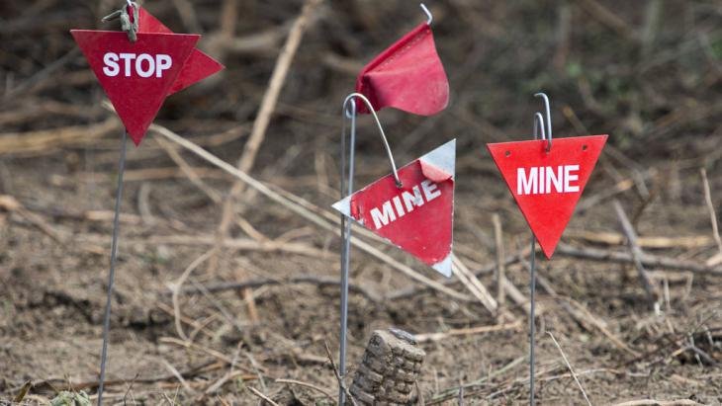

Questions?

